Slide 1
Managing Risks and Safety
Richard Cattell
Deputy Chief Pharmaceutical Officer
September 2019

Slide 2
Outline
What do we mean by risk and safety?
3 case studies
Implementation of EPMA
Introduction of biosimilar medicines
Medicines Safety Self Assessment Framework
Medicines Governance in NHS providers
Overarching lessons
The role for medicines information

Slide 3
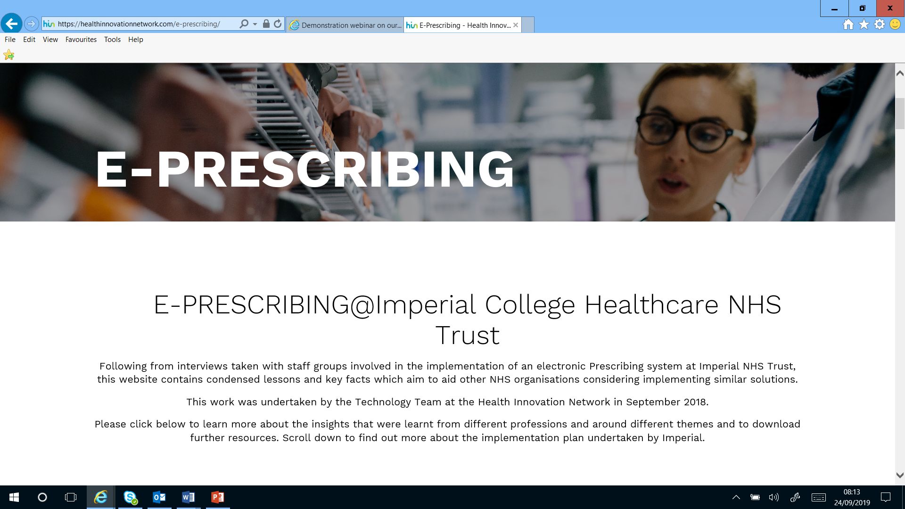

Slide 4
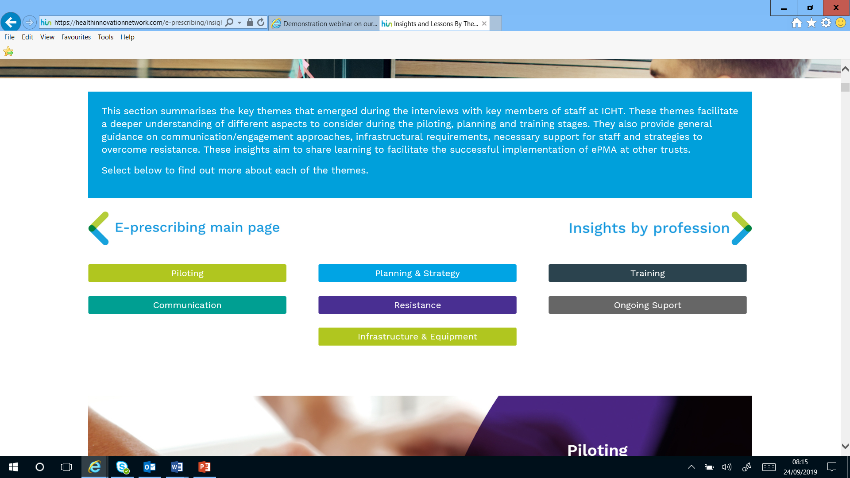

Slide 5
Considerable expectation!
Availability of the medicine
Understanding the patient view
Understanding the prescribers view
Balancing local and national perspectives
Learning from
other similar processes
other countries
Regular communication

Slide 6
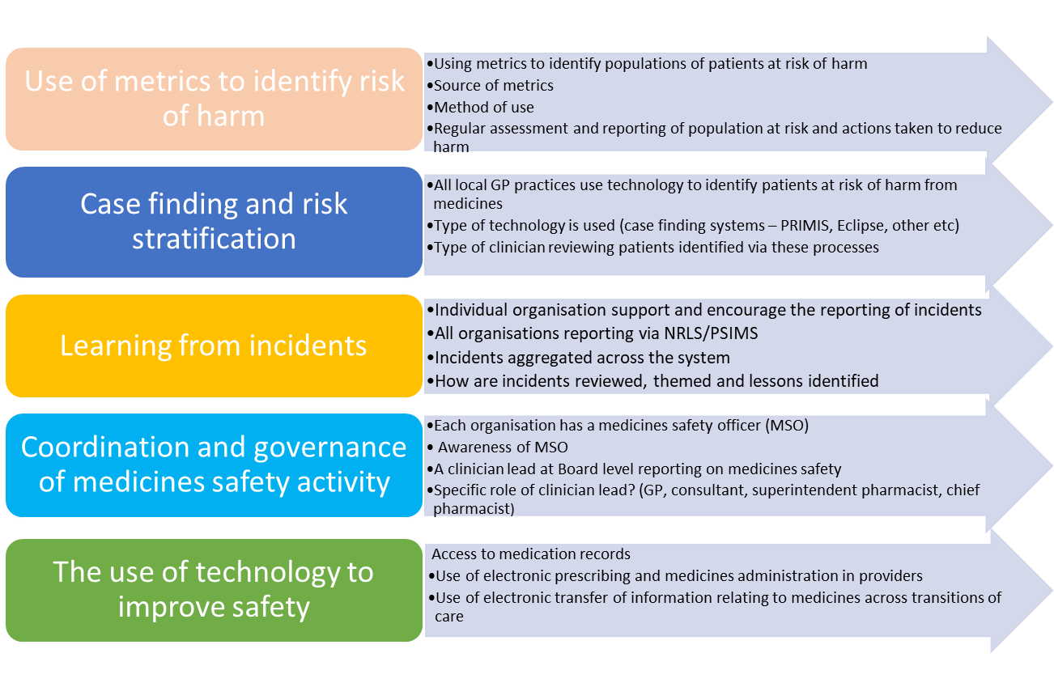
Draft Medicines Safety Self-Assessment Framework
System approach to medicines safety

Slide 7
Proposing best practice in medicines governance
Domain | Elements
Policy | Robust policy development and review process Overarching and enabling policies Including PGDs, procedures
Technology | Safe implementation, ongoing optimisation Across the activities within medicines handling Secondary use of data to drive care, quality improvement
Data to drive care | Using metrics and data to describe opportunity, risk, prioritise patients, demonstrate performance Shared with directorates, divisions and executive
Reporting and Learning from Incidents | Support for reporting incidents Multidisciplinary review, theming and learning Interventions identified, delivered and assessed
Engagement and leadership | Staff and patient survey Relationships with wards, patients, business units, Boards
Lean and productive governance | Regular reporting to wards, business units, and Board Regular reporting to partners

Slide 8
Overarching lessons
Multi-disciplinary approach
Engage with patients
Be pro-active in searching for and mitigating risks and issues
Use data to measure harm, risk and impact of change where possible
Ensure there is a structure in place to escalate
Regularly and clearly communicate
Learn from those who are making good progress
Medicines Information is well placed and well versed to be central to the management of risk and assurance of safety relating to medicines

Slide 9
Thank you for listening Any Questions???
Get in contact
rcattell@nhs.net @RichardCattell1

